Slide 1
Online Bakery Management System
CMT 400 : Research Project Final Report
Name : Jane Karuga| REG. Num: 1040477
Supervisor: Michael Kinyua

Slide 2
Content
Background of the Research
Problem Statement
Main & Specific Objectives
Analysis
Design
Implementation

Slide 3
Background of the research
With the current advances in technology, bakeries need to embrace adaptability to the new area of digitization in order to keep up with the competitive game in their industries.
This does not only limit to large businesses but also small businesses that have a goal for growth in their business. This includes introduction to Online Bakery Management Systems to the local retail bakeries so that customers can have an easy access to book online for their cakes and pastries and also the store can have an efficient way of managing their customers from their end and be well prepared even for their busy days.

Slide 4
Main & Specific Objectives
Main Objective: To design and develop an Online Bakery Management System that will enhance customer outreach for small scale bakery businesses in Kenya.
Specific Objectives:
To determine user requirements for the envisioned system.
To develop conceptual and technical designs based on the user requirements.
To implement the designed system using appropriate programming languages and technologies.
To execute testing procedures so as to identify and address any defects or discrepancies of the developed system.

Slide 5
Analysis(1)
Functional requirements
User Interaction: User Registration, Admin Registration.
Placing of orders by the customer successfully.
Bakery owner(admin) to update the menu with ease, which includes Creation and Updating of the products in the store depending on their availability and their prices.
Provision of recommendations
Non- Functional requirements
User friendly User Interface
Responsive Design
Compatibility
Availability
Efficiency
Reliability

Slide 6
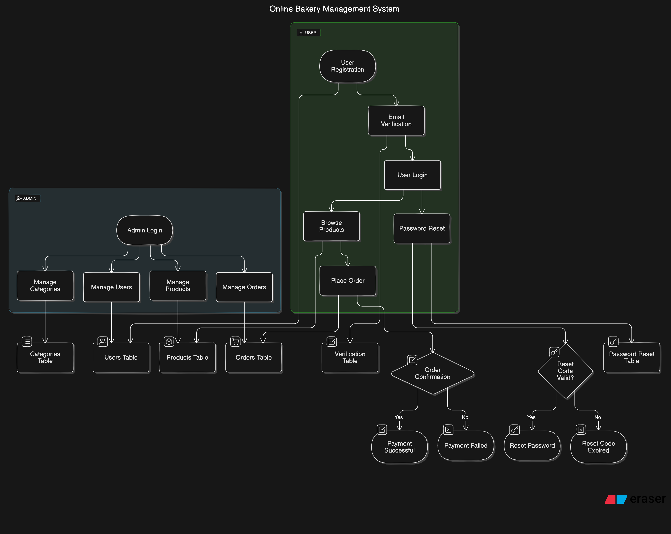
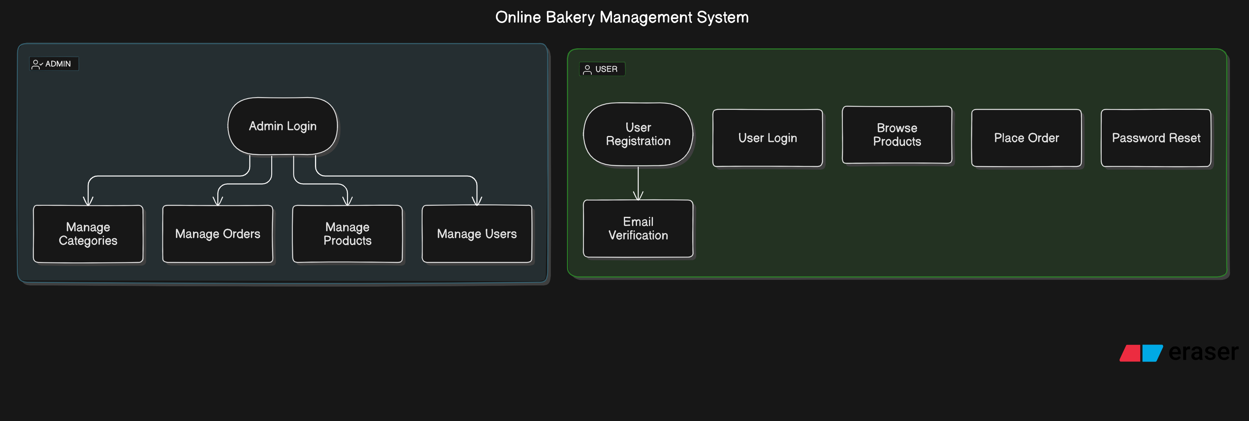
Analysis(2)

Slide 7
Analysis(3)
System users/actors
Bakery Owner
Bakery customers
System Input/ Input forms
Custom cake order,Login,Admin product insertion
System output/ Reports
Order Reports completed,Inventory reports, Product Reports
System Entities
Bakery, Customer, Order, Order item, Product, Inventory

Slide 8
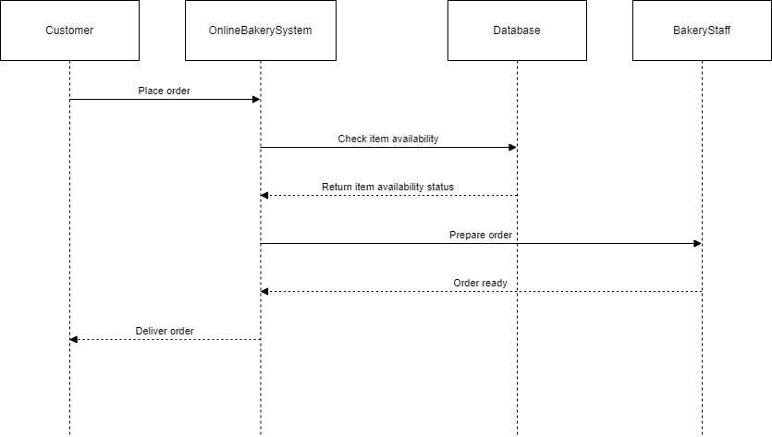
System Design (1)-Sequence Diagram

Slide 9
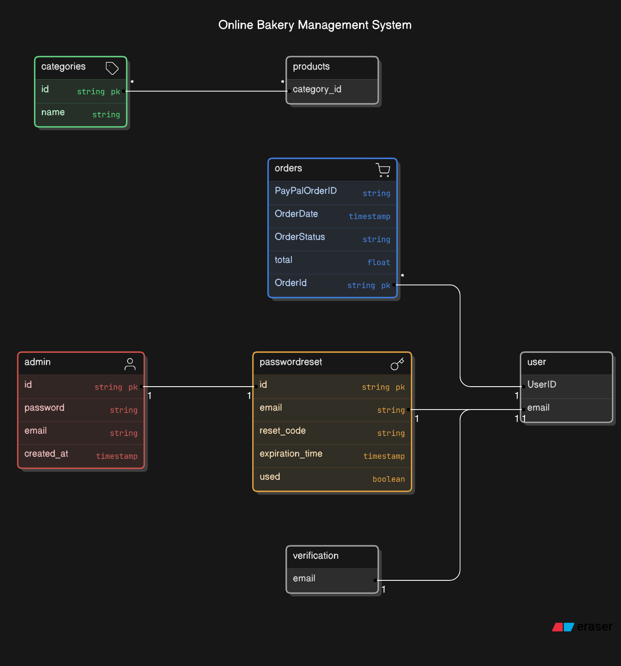
Design(2)-ERD Diagram

Slide 10
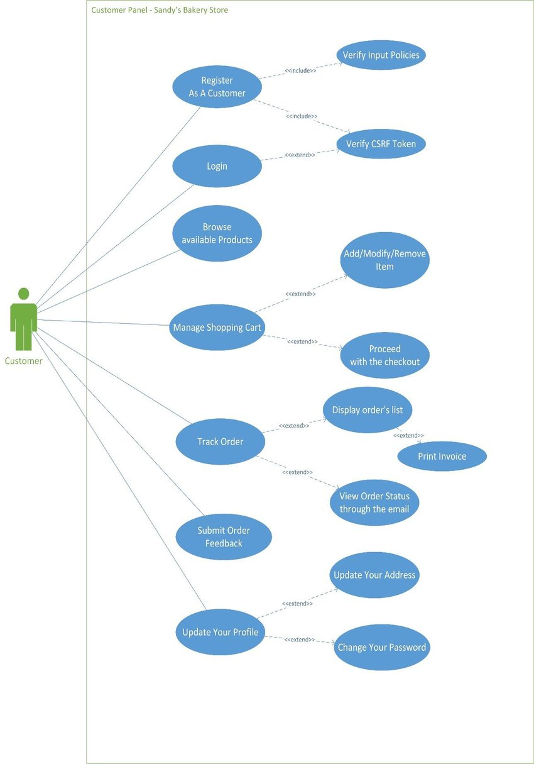
Design (3) Use Case Diagram

Slide 11
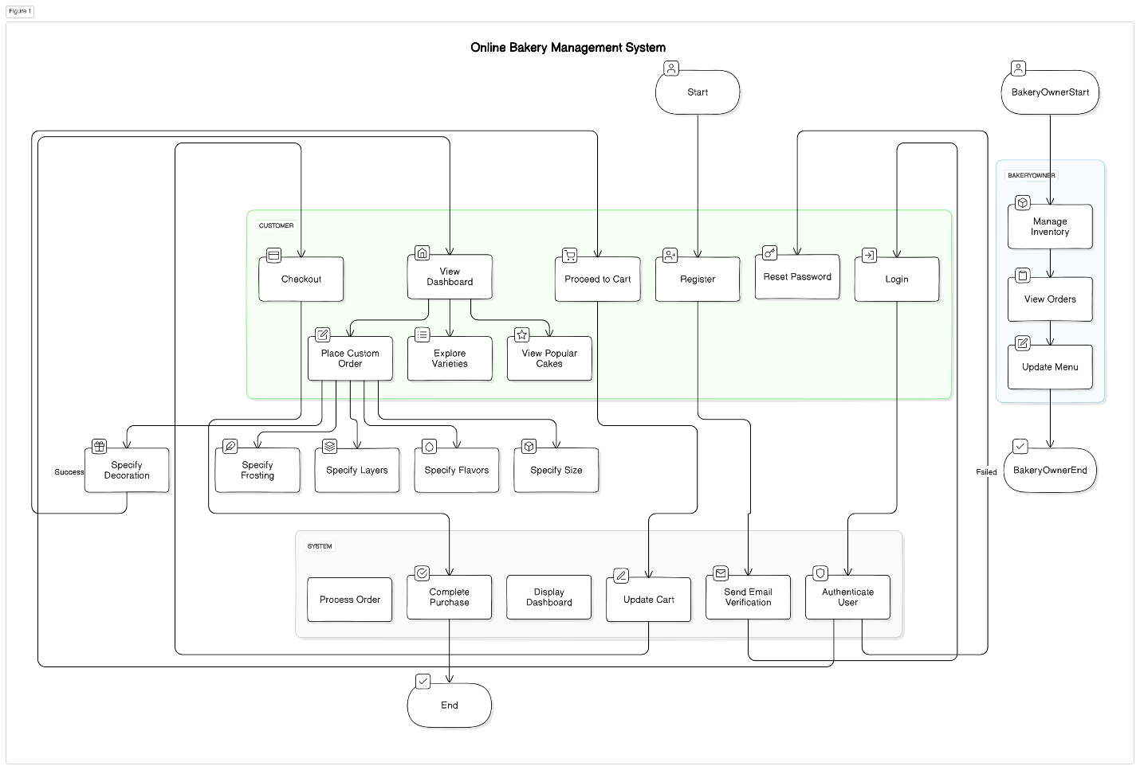
Design (4)Activity Diagram

Slide 12
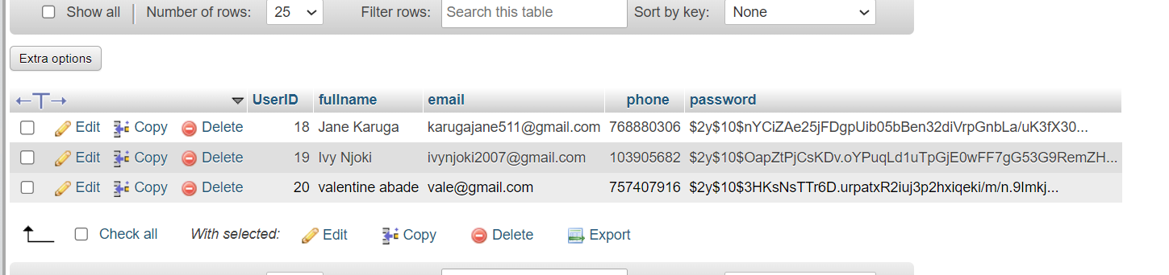
Design(5)
Test data

Slide 13
Implementation
Implementation of signup page for both user and admin
Creation of user and admin dashboard
Creation of gallery for standard orders which can be added to cart successfully
Creation of custom order page where user can choose size,flavour types,number of layers,decoration range and frosting type
Creation of checkout page and intergrated to mpesa API
Implementation of database

Slide 14
The End
Thank you
[proceed to invite the panel to your system /prototype presentation]

